Slide 1
Convolutional Methods for Time Series Classification
KDD 2024 Workshop
A Hands-on Introduction to Time Series Classification and Regression
Professor Geoff Webb
Monash University

Slide 2
Outline
Convolution / Convolutional Kernels
Methods
Rocket
MiniRocket
MultiRocket
Hydra
Examples (aeon)

Slide 3
Convolution

Slide 4

Time Series

Slide 5
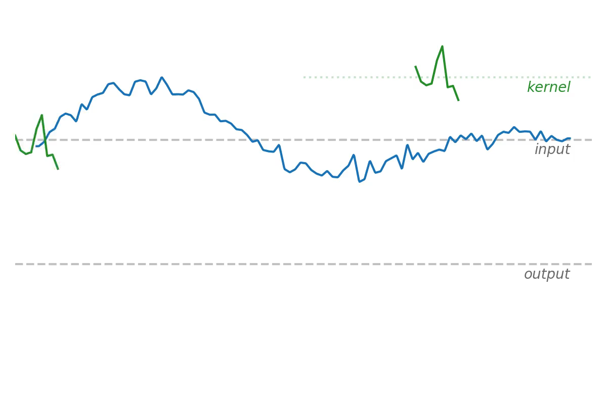
Convolution

Slide 6
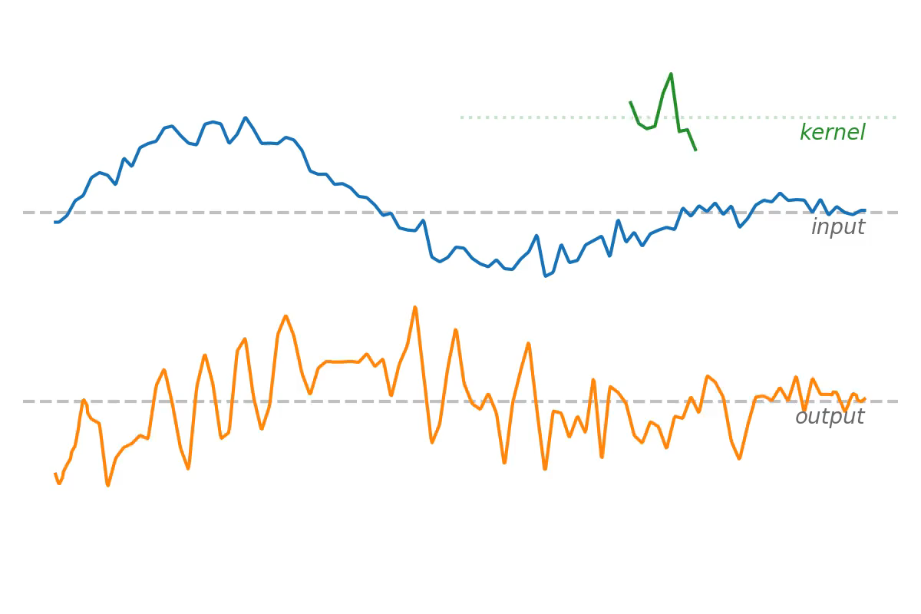
Different Weights + Dilations

Slide 7
Convolution
Kernel: a vector of weights
Sliding dot product (captures local temporal ordering)
Pooling operations (global temporal invariance)
Max
PPV (“proportion of positive values”)
A single mechanism which allows for capturing
different features
different scales

Slide 8
Convolutional Methods
The Rocket “Family” of Methods

Slide 9
Rocket
Transform time series using a large number of random convolutional kernels
Use the transformed features to train a simple linear classifier
10K random convolutional kernels
Random: length, weights, bias, dilation, and padding
Pooling
Max
PPV
Ridge classifier

Slide 10
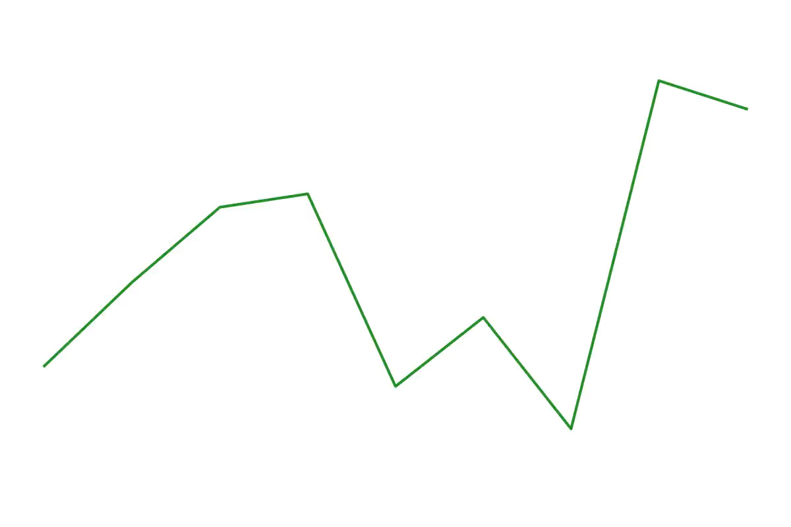
10K Random Kernels

Slide 11
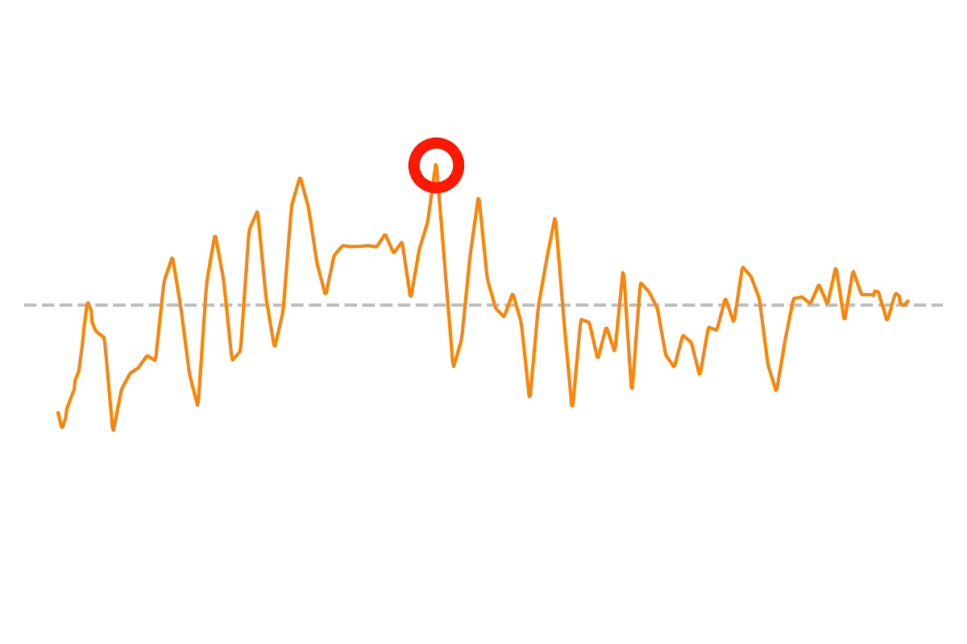
Max Pooling

Slide 12
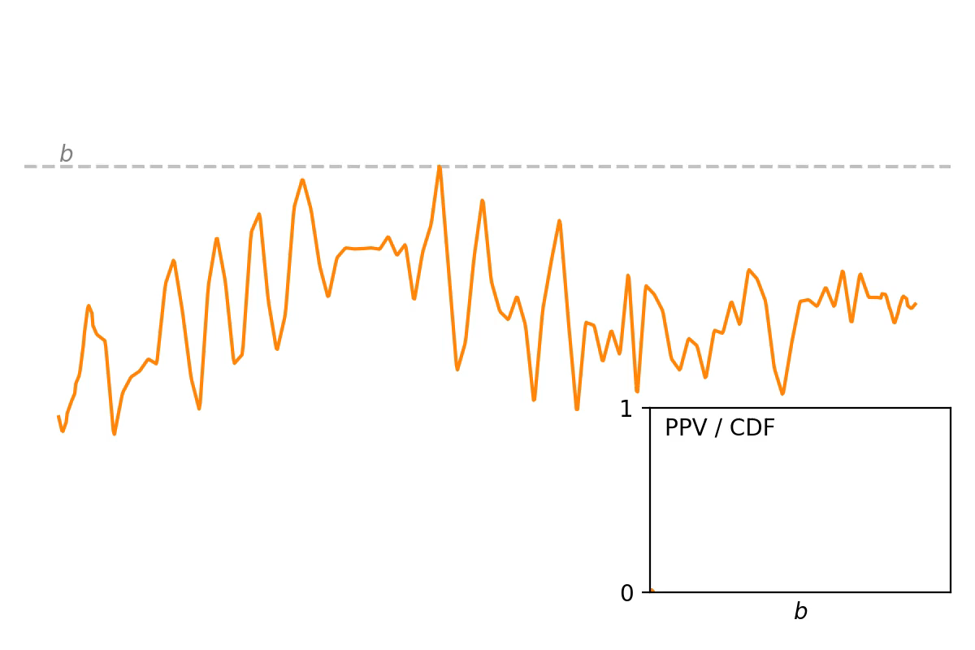
PPV Pooling

Slide 13
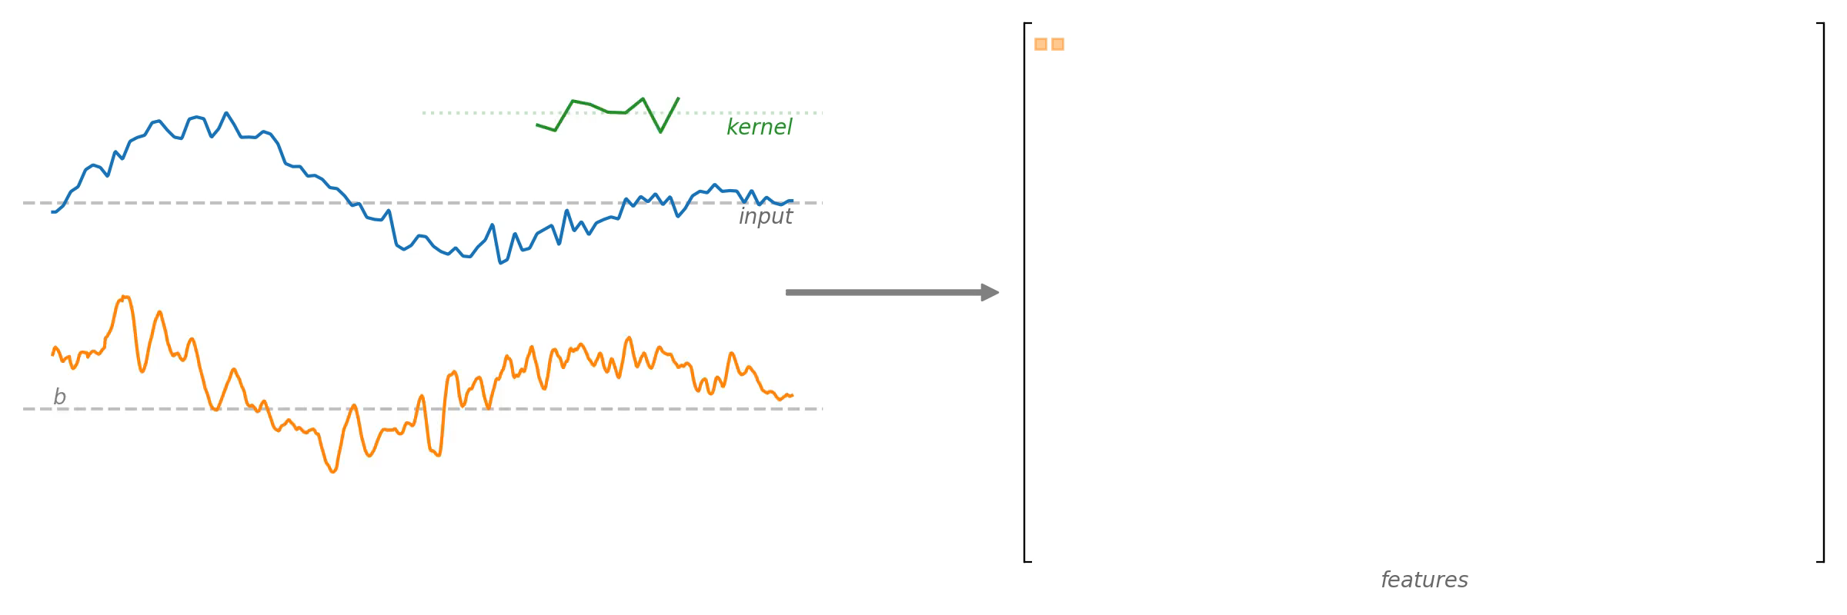
}
Transformed Features → Ridge Classifier
linear classifier

Slide 14
MiniRocket
Random → fixed kernels
10,000 → 84 kernels (per dilation)
PPV only
Highly optimised (much faster than Rocket)

Slide 15
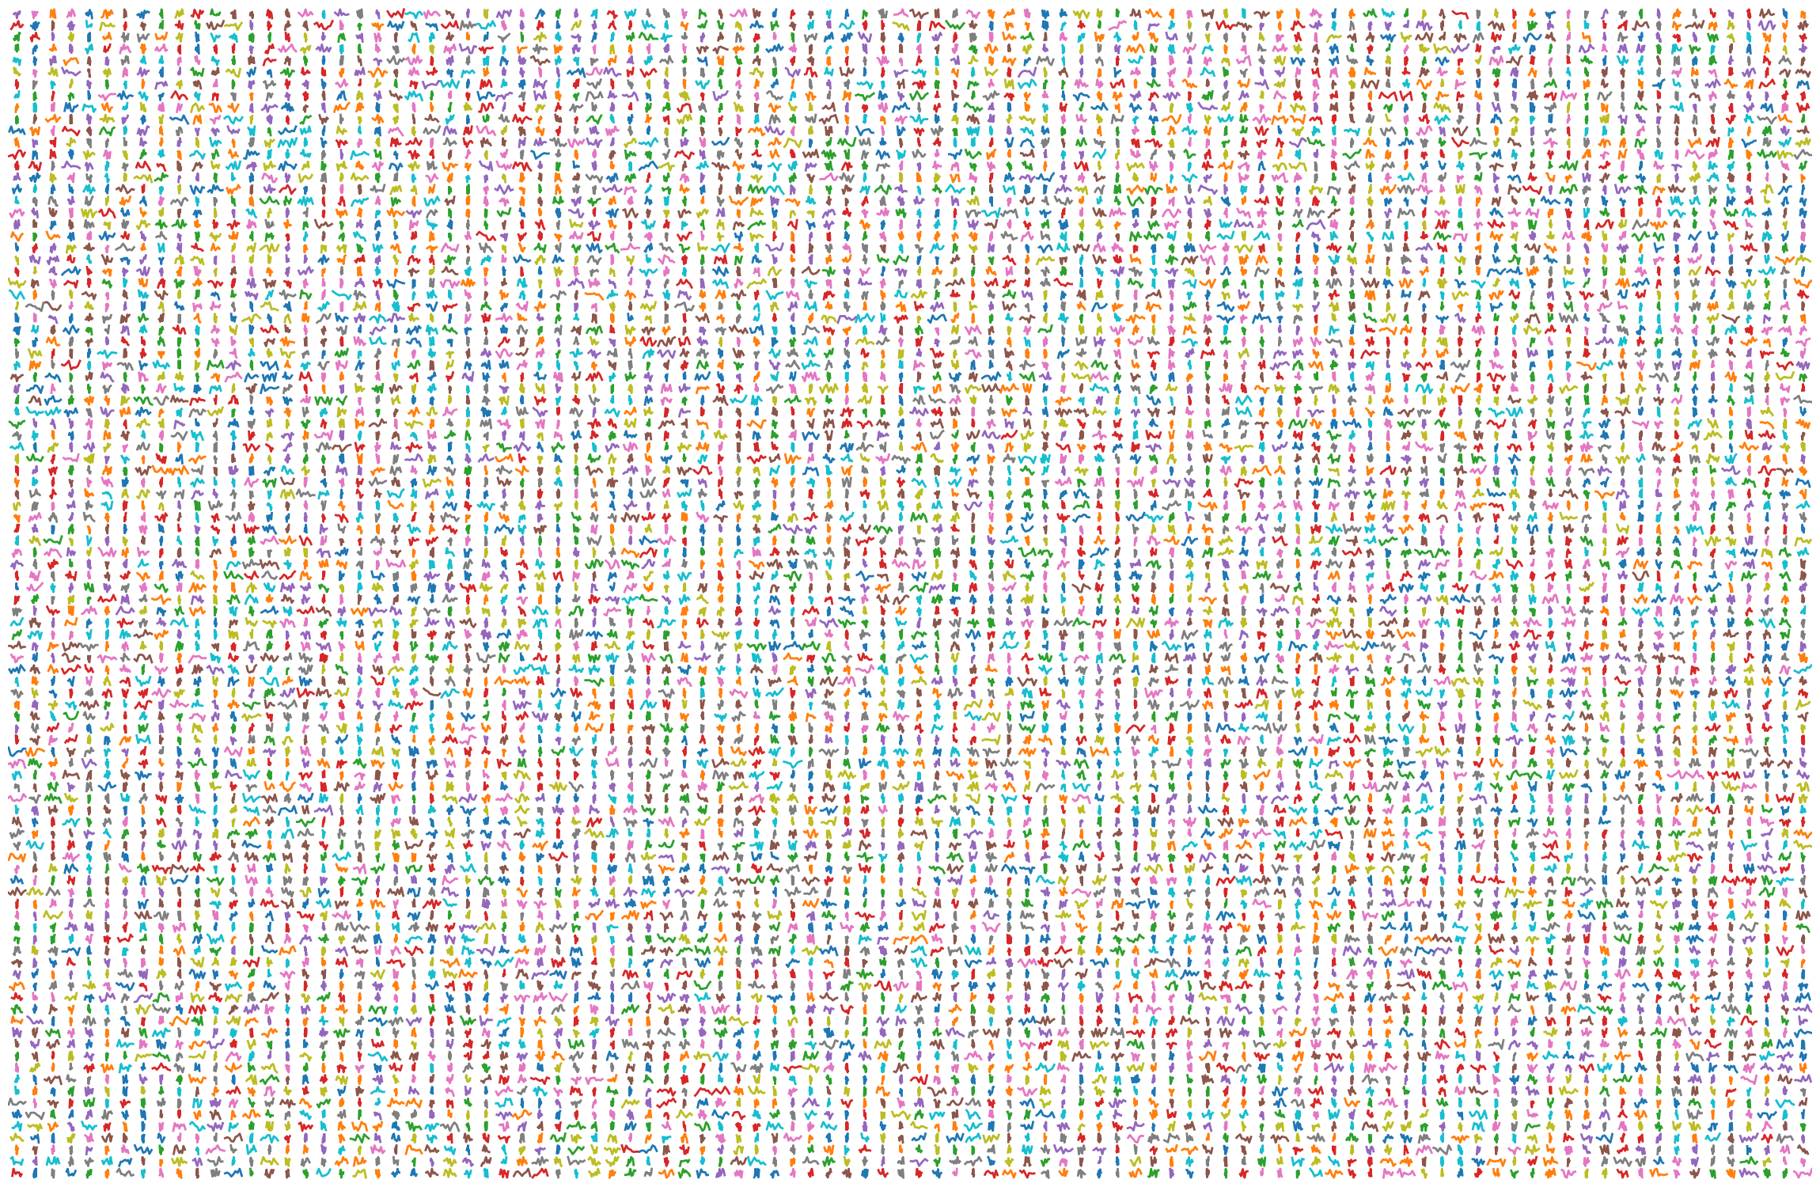
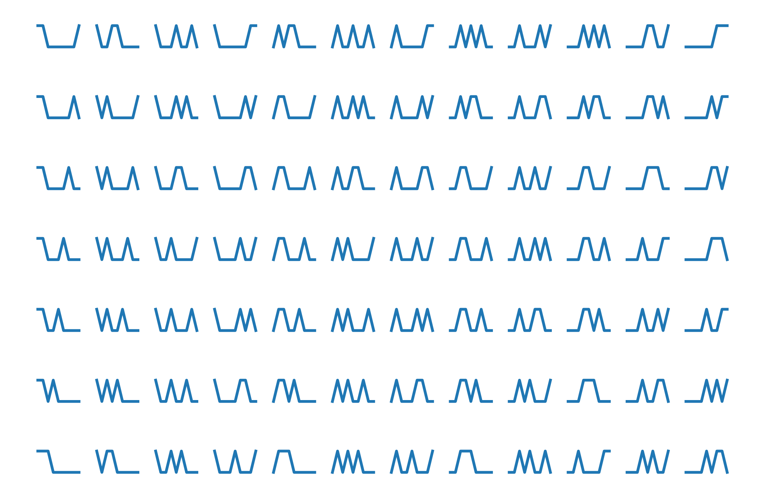
10,000 Random → 84 Fixed Kernels

Slide 16
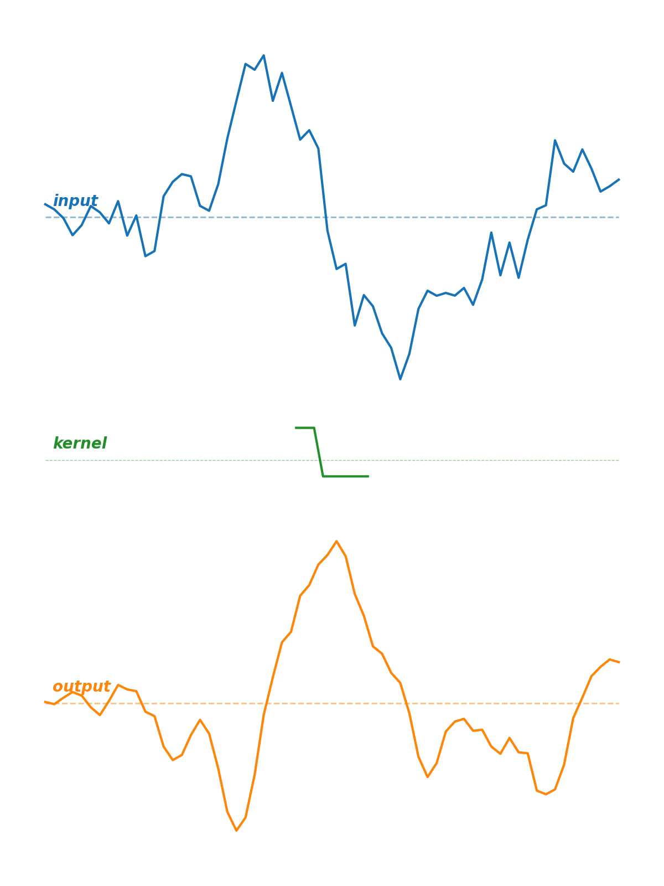
Convolution w/ MiniRocket Kernels

Slide 17
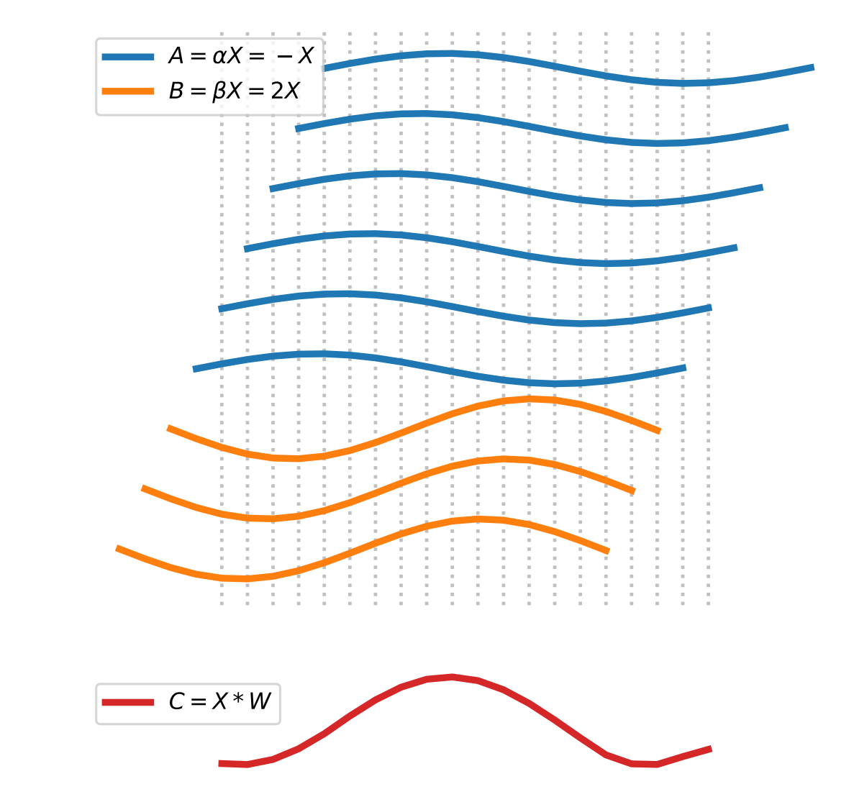
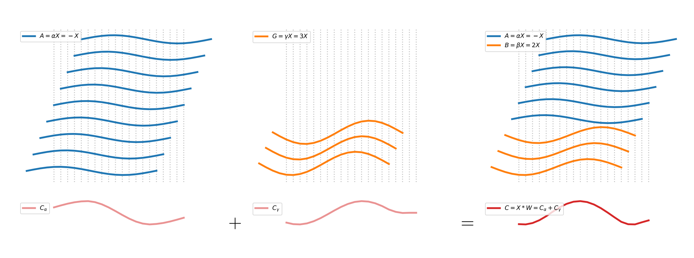
Optimisations
(1) Fewer kernels (84 vs 10,000)
(2) Reuse conv. output
(3) Conv. by addition
(4) Conv. for all kernels ‘at once’

Slide 18
MultiRocket
MiniRocket plus additional pooling operators (plus 1st difference)
Rocket and MiniRocket “miss”: the magnitude of the response, the location of the response, the most prominent single response
MultiRocket uses PPV plus:
MPV: mean of positive values
MIPV: mean indices of positive values
LSPV: longest stretch of positive values
Similar speed to MiniRocket, significantly more accurate (on average)

Slide 19
Hydra
Combine Rocket + dictionary methods
Dictionary methods: count symbolic patterns
Hydra: count random patterns (represented by random convolutional kernels)
Organise kernels into “groups”
Count the kernel in each group with the max output at each timepoint
I.e., “competing” convolutional kernels
Combine with MultiRocket (“MultiRocket+Hydra”)

Slide 20
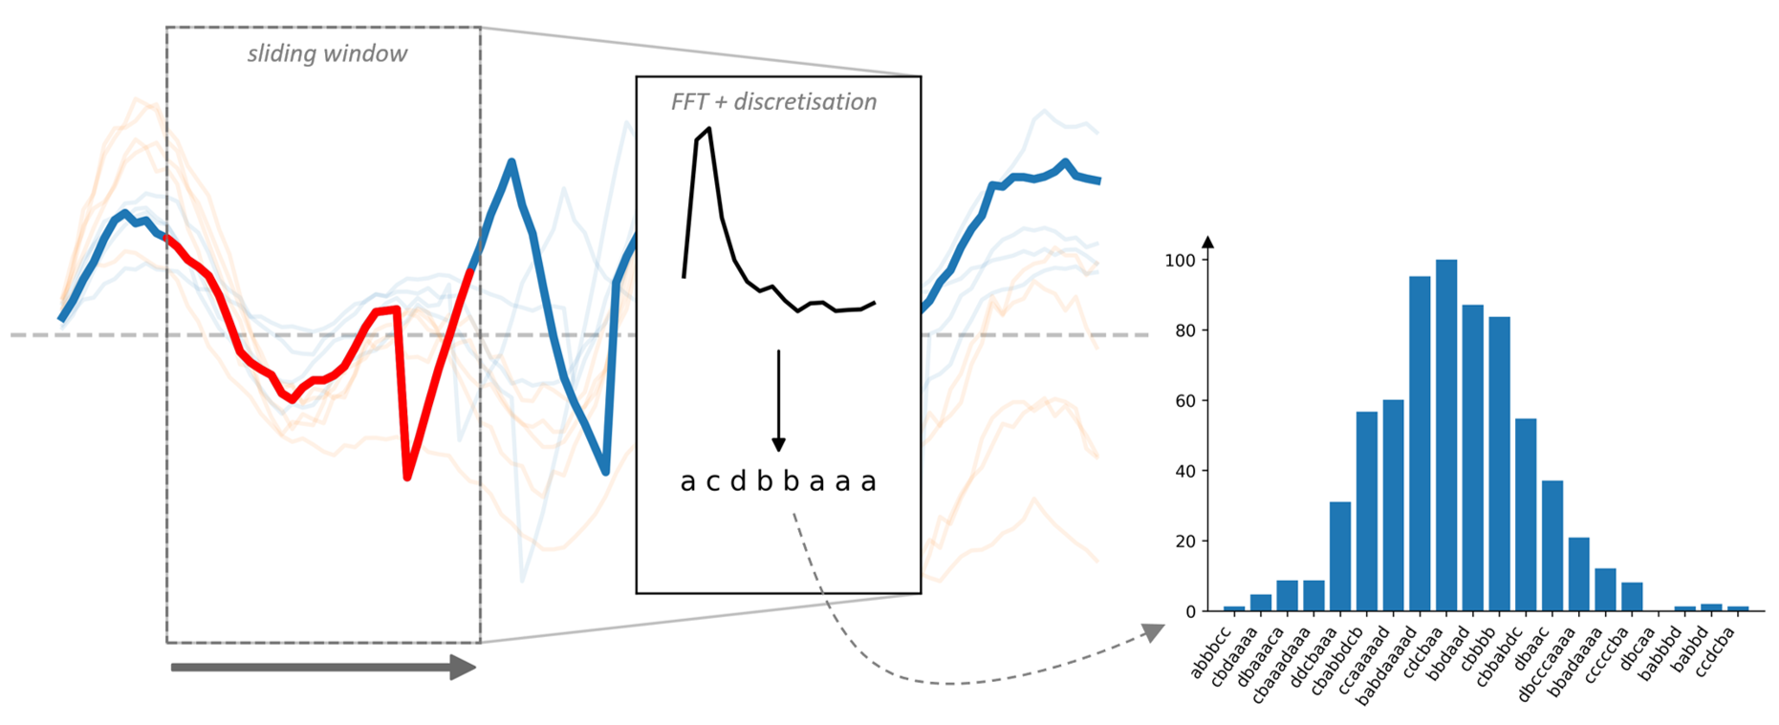
Dictionary Methods

Slide 21
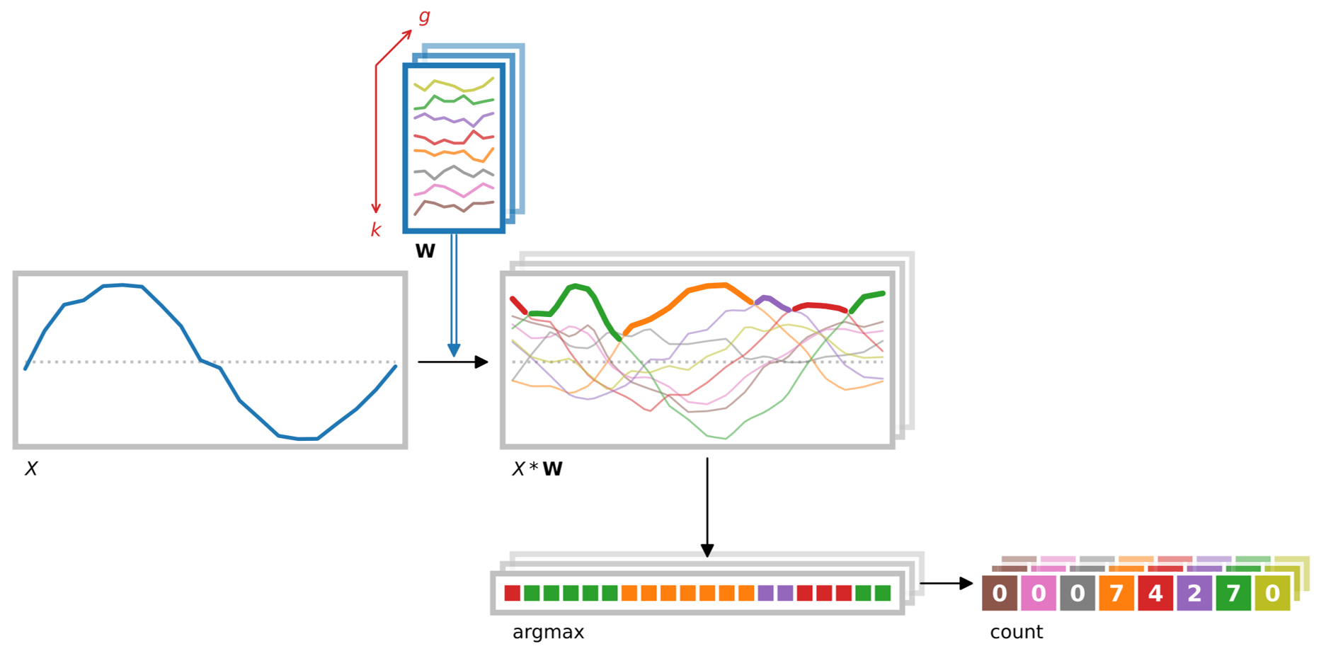
Hydra

Slide 22
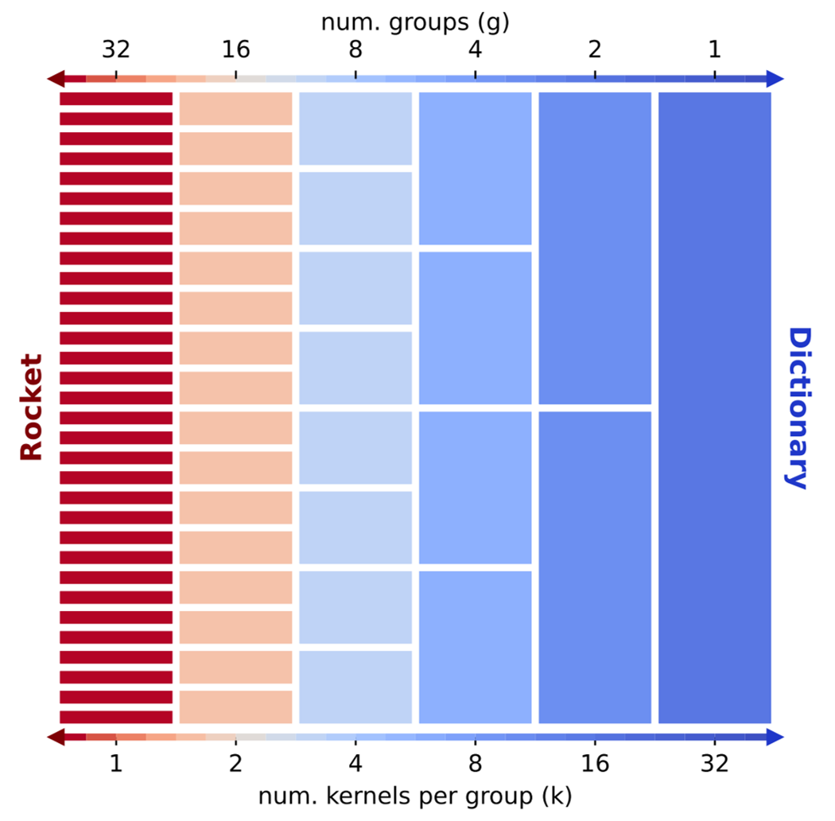
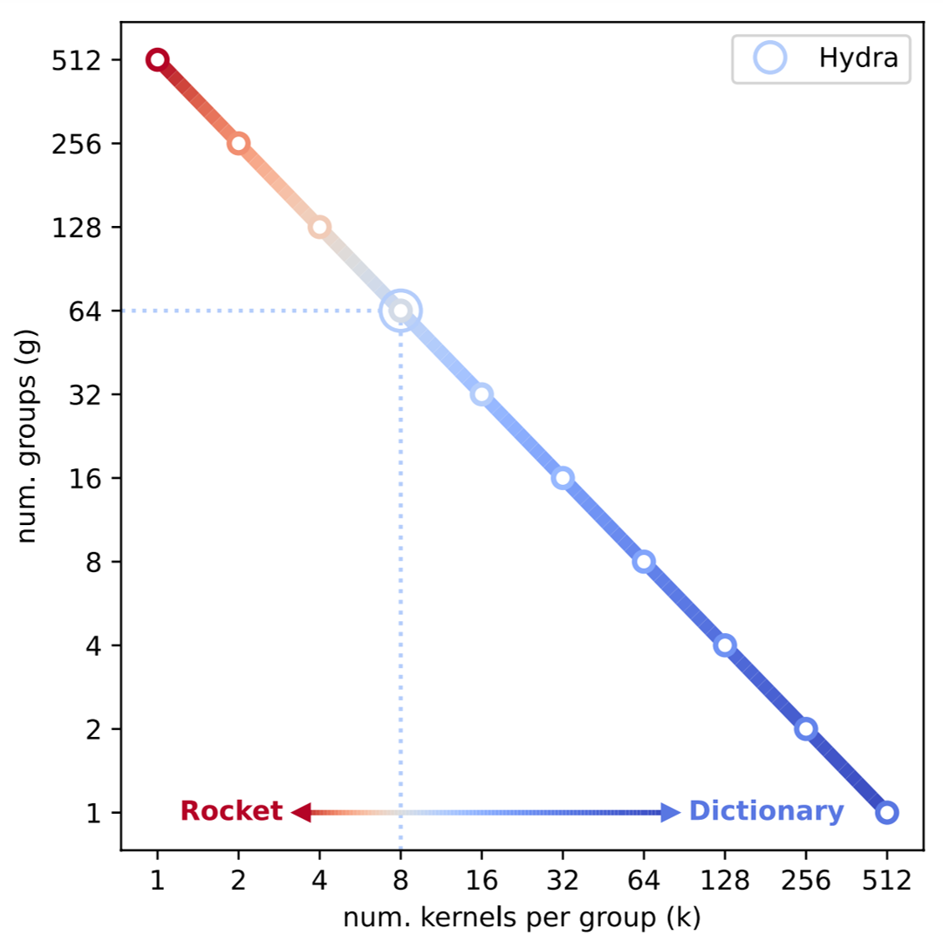

Slide 23
Summary

Slide 24
Summary
Convolution
Methods
Rocket random kernels + max & ppv + linear classifier
MiniRocket fixed kernels + ppv + optimisations
MultiRocket MiniRocket + additional pooling
Hydra competing kernels

Slide 25
Examples
Convolutional methods
Parameter tuning
(switch to notebook)

